Slide 1

Counting Inversions
Give an algorithm that determines the number of inversions in any permutation on $n$ elements in $O\left(n\log{n}\right)$ worst-case time.
4 inversions
(2,1), (3,1), (4,1), (5,1)
2 | 3 | 4 | 5 | 1

Slide 2


Counting Inversions
Hint: (# of inversions in $S$) = (# of inversions in $S^{′}$) + (# of inversions in $S^{′′}$) + (# of inversions involving one element from $S^{′}$ and $S^{′′}$)
Modify merge sort
$$S$$
$$S^{′}$$ | $$S^{′′}$$

Slide 3
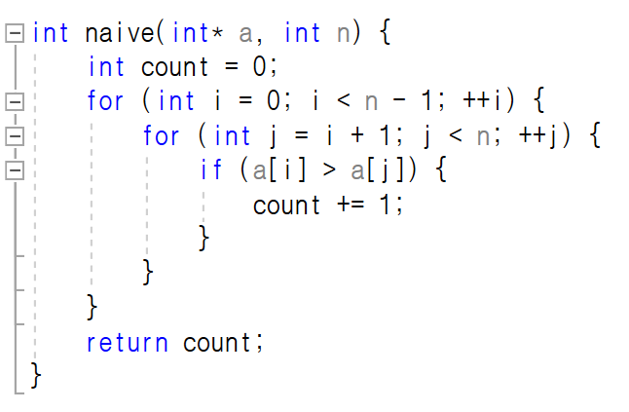

Naïve
Enumerate all cases $O(n^{2})$

Slide 4
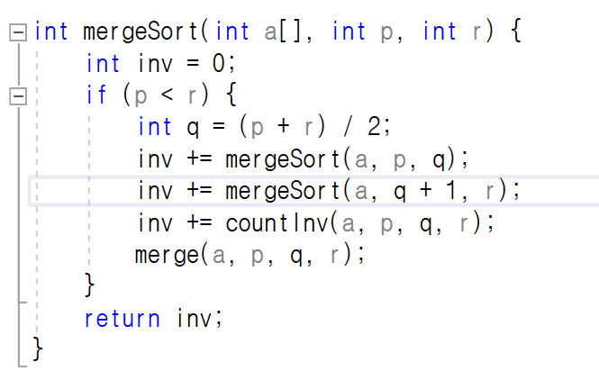
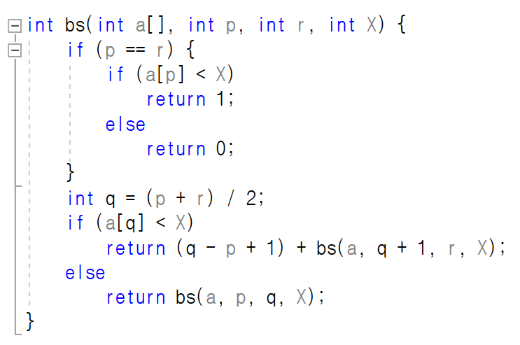
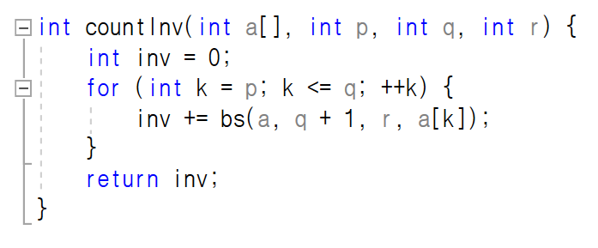
Divide Conquer
Using modified binary search

Slide 5

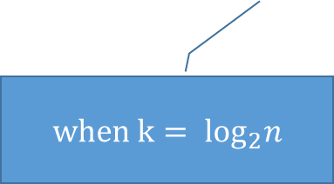

Time Complexity
$T\left(n\right)=2T\left(\frac{n}{2}\right)+n\log_{2}n$
$\frac{T\left(n\right)}{n}=\frac{T\left(n/2\right)}{n/2}+\log_{2}n$
$\frac{T\left(n/2\right)}{n/2}=\frac{T\left(n/2^{2}\right)}{n/2^{2}}+\log_{2}\left(n/2\right)$
$…$
$\frac{T\left(n/2^{k−1}\right)}{n/2^{k−1}}=\frac{T\left(n/2^{k}\right)}{n/2^{k}}+\log_{2}\left(\frac{n}{2^{k−1}}\right)$
when $k=\log_{2}{n}$
$\frac{T\left(n\right)}{n}=\frac{T\left(1\right)}{1}+\sum_{i=0}^{k−1}{\log_{2}\left(\frac{n}{2^{i}}\right)}$
$T\left(n\right)=O{\left({n(log}_{2}{n }\right)}^{2})$
$$∵\sum_{i=0}^{k−1}{\log_{2}\left(\frac{n}{2^{i}}\right)= }\sum_{i=0}^{k−1}{(\log_{2}n −\log_{2}{2^{i}})}$$
$$=\sum_{i=0}^{k−1}{(\log_{2}n −i)}$$
$$=k\log_{2}n −\frac{\left(k−1\right)k}{2}$$
$$={\left(\log_{2}{n }\right)}^{2} −\frac{(\log_{2}{n }−1)\log_{2}{n }}{2}$$
$$=O{\left({(log}_{2}{n }\right)}^{2})$$
$${when k= log}_{2}n$$

Slide 6
Main Idea for More Efficient Algorithm
if (L[i] > R[j]) {
A[k] = R[j++];
inv += n1 – i;
} else { …
Merging
2 | 3
n1 = mid – left + 1;
2 | 5 | 7 | 8
3 | 4 | 6 | 9
i: 1
j: 1

Slide 7
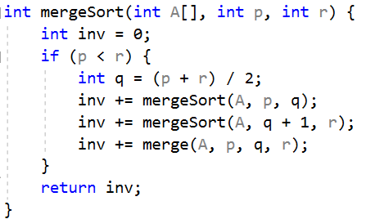
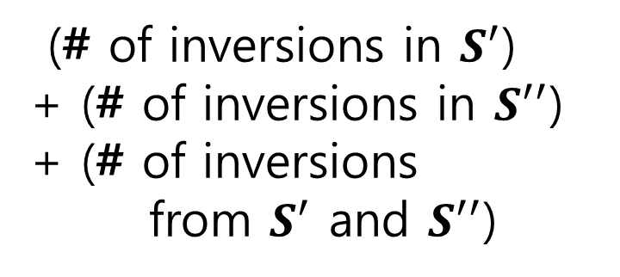
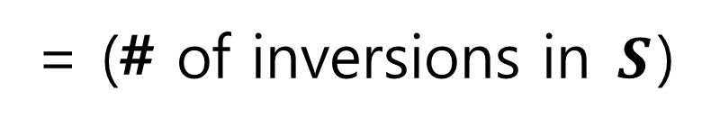
Solution (Algorithm)
(# of inversions in $S^{′}$)
+ (# of inversions in $S^{′′}$) + (# of inversions
from $S^{′}$ and $S^{′′}$)
= (# of inversions in $S$)

Slide 8

Merge
Hint: (# of inversions in $S$) = (# of inversions in $S^{′}$) + (# of inversions in $S^{′′}$) + (# of inversions involving one element from $S^{′}$ and $S^{′′}$)
2 | 5 | 7 | 8
3 | 4 | 6 | 9

Slide 9
Merge
Hint: (# of inversions in $S$) = (# of inversions in $S^{′}$) + (# of inversions in $S^{′′}$) + (# of inversions involving one element from $S^{′}$ and $S^{′′}$)
+3
2 | 5 | 7 | 8
3 | 4 | 6 | 9

Slide 10
Merge
Hint: (# of inversions in $S$) = (# of inversions in $S^{′}$) + (# of inversions in $S^{′′}$) + (# of inversions involving one element from $S^{′}$ and $S^{′′}$)
+3
+3
2 | 5 | 7 | 8
3 | 4 | 6 | 9

Slide 11
Merge
Hint: (# of inversions in $S$) = (# of inversions in $S^{′}$) + (# of inversions in $S^{′′}$) + (# of inversions involving one element from $S^{′}$ and $S^{′′}$)
+3
+3
2 | 5 | 7 | 8
3 | 4 | 6 | 9

Slide 12
Merge
Hint: (# of inversions in $S$) = (# of inversions in $S^{′}$) + (# of inversions in $S^{′′}$) + (# of inversions involving one element from $S^{′}$ and $S^{′′}$)
+3
+3
+2
2 | 5 | 7 | 8
3 | 4 | 6 | 9

Slide 13
Merge
Hint: (# of inversions in $S$) = (# of inversions in $S^{′}$) + (# of inversions in $S^{′′}$) + (# of inversions involving one element from $S^{′}$ and $S^{′′}$)
+3
+3
+2
2 | 5 | 7 | 8
3 | 4 | 6 | 9

Slide 14
Merge
Hint: (# of inversions in $S$) = (# of inversions in $S^{′}$) + (# of inversions in $S^{′′}$) + (# of inversions involving one element from $S^{′}$ and $S^{′′}$)
+3
+3
+2
2 | 5 | 7 | 8
3 | 4 | 6 | 9

Slide 15
Merge
Hint: (# of inversions in $S$) = (# of inversions in $S^{′}$) + (# of inversions in $S^{′′}$) + (# of inversions involving one element from $S^{′}$ and $S^{′′}$)
+3
+3
+2
2 | 5 | 7 | 8
3 | 4 | 6 | 9

Slide 16
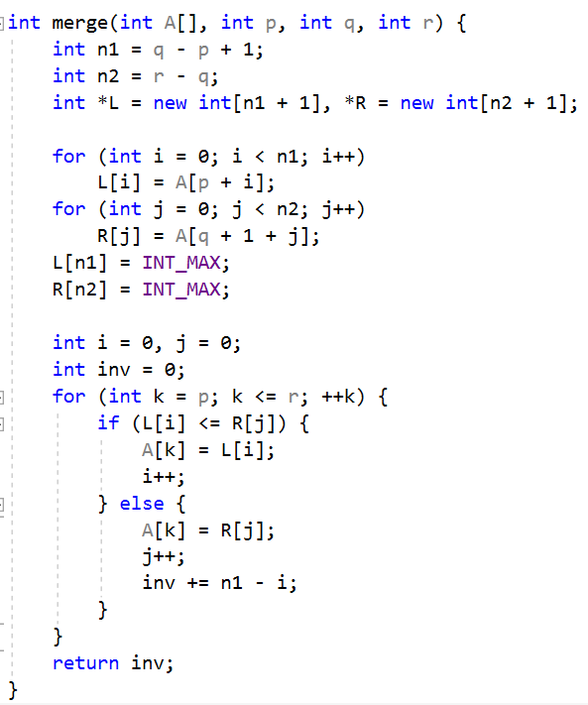
Solution (Algorithm)

Slide 17
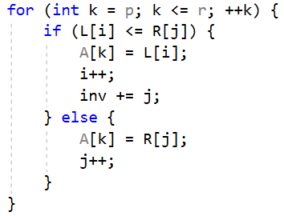
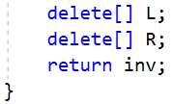
Solution (Algorithm)
or

Slide 18
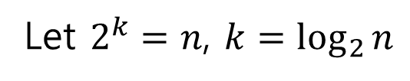

Time Complexity
Recurrence equation
$T\left(n\right)=2×T\left(\frac{n}{2}\right)+n$
$T\left(n\right)=2×\left(2×T\left(\frac{n}{4}\right)+\frac{n}{2}\right)+n=2^{2}×T\left(\frac{n}{2^{2}}\right)+2n$
…
$T\left(n\right)=2^{k}×T\left(\frac{n}{2^{k}}\right)+kn$
$T\left(n\right)=n×T\left(1\right)+n\log_{2}{n}=O\left(n\log{n}\right)$
Let $2^{k}=n$, $k=\log_{2}{n}$

